Slide 1

Week #2
AI Academy®
1
Day 1:
Introduction to Shopify
Shopify Platform Benefits
Shopify Account Creation
Shopify Plans & Important Features
Guidance and support for Account verifications

Slide 2
Week #2
AI Academy®
2
Important points to know:
Learn Shopify
Learn Digital Marketing and SEO
Niche Selection
Store Optimization
Customer Support

Slide 3
Week #2
AI Academy®
3
Important points to know:
Reliable Sourcing
Multiple Suppliers
Payment Methods
Important Apps integration

Slide 4
Week #2
AI Academy®
4
Day 2:
Introduction to Shopify Dashboard
Various Sections and Tools
Order Management
Create Mock Orders
Reviews & Feedbacks

Slide 5
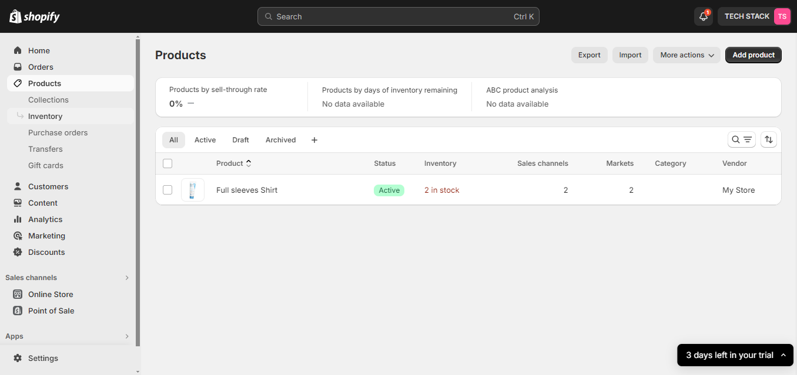
Week #2
AI Academy®
Dashboard Products:
5

Slide 6
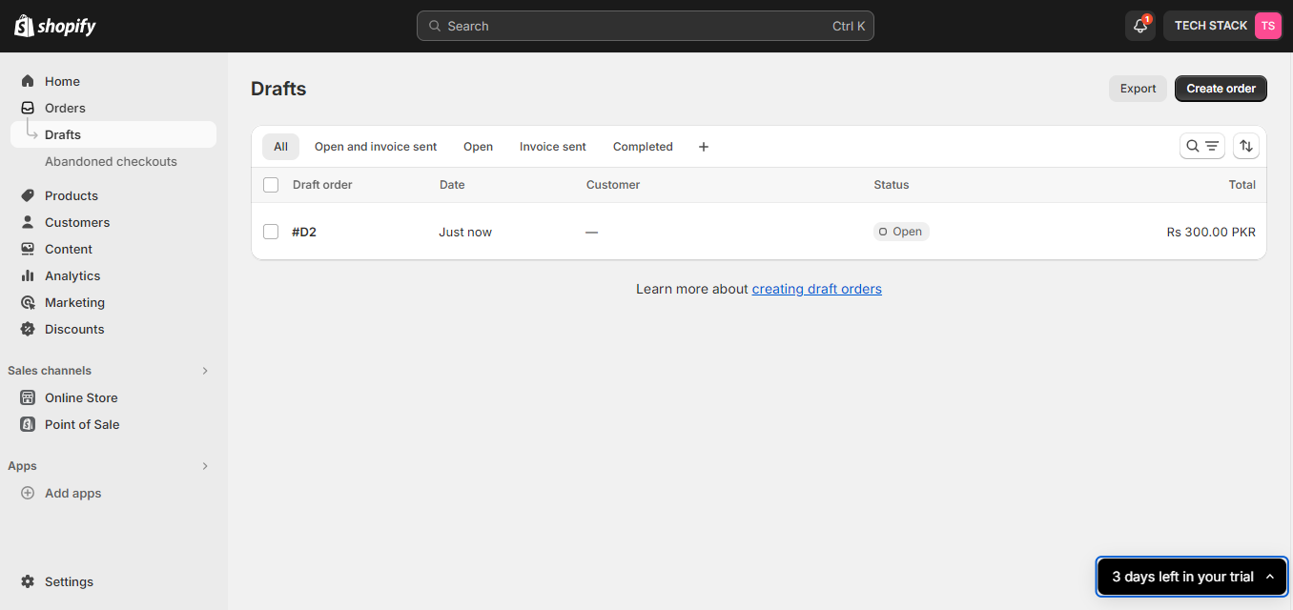
Week #2
AI Academy®
Dashboard Mock Orders:
6

Slide 7
Week #1
AI Academy®
7
Day 3:
Product listing guidelines
Listing requires
Title, Description, Images
Creating Sample Product
Review and Feedback on listing

Slide 8
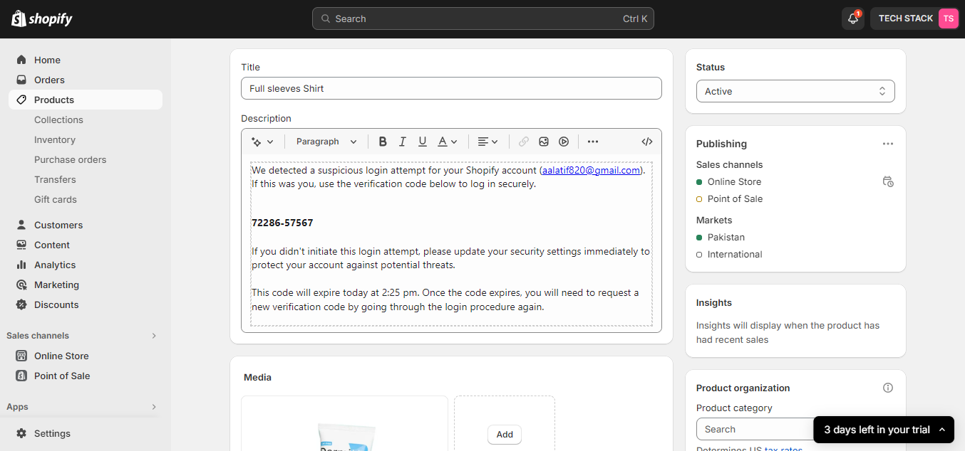
Week #2
AI Academy®
Dashboard Product Listing:
8

Slide 9
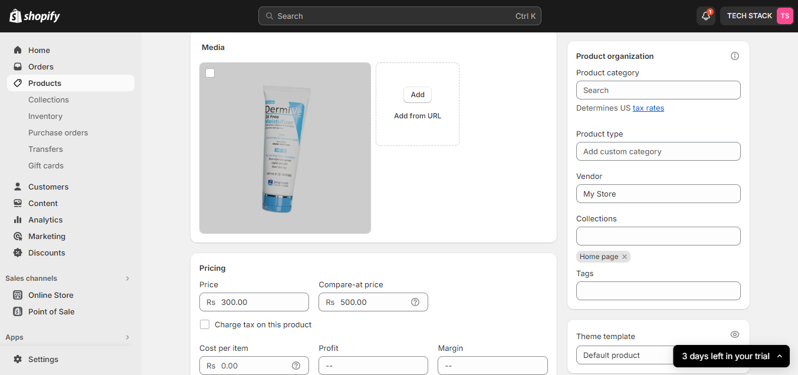
Week #2
AI Academy®
Dashboard Product Listing:
9

Slide 10
Week #1
AI Academy®
10
Day 4:
Explore Shopify Store front-end
Guidelines, personalizing
Banners, logos and Brand identity
Troubleshooting and assistance

Slide 11
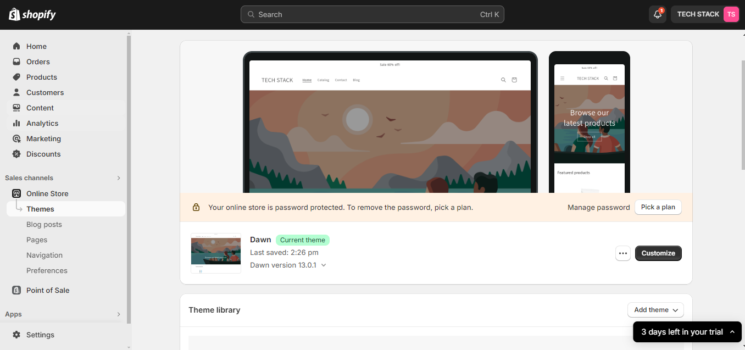
Week #2
AI Academy®
Dashboard Store Frontend Designing:
11

Slide 12
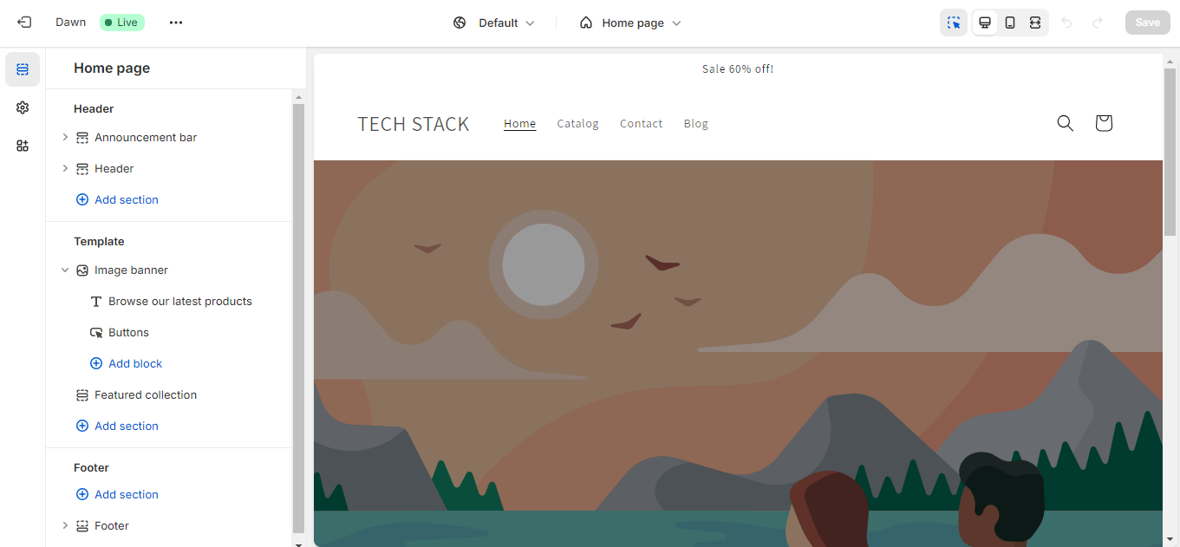
Week #2
AI Academy®
Dashboard Store Frontend Designing:
12

Slide 13
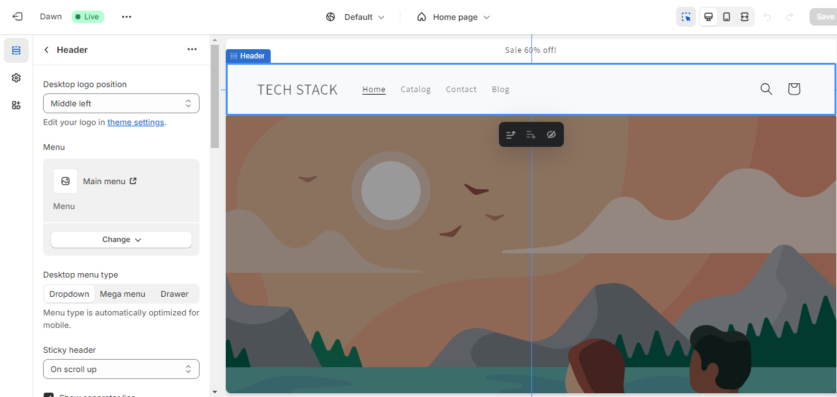
Week #2
AI Academy®
Dashboard Store Frontend Designing:
13

Slide 14
Week #1
AI Academy®
14
Day 5:
Overview Marking tools for Shopify Store
Explanation Offers
Promotions, discounts and Sponsoring
Inquiries and managing Orders
Review Inquiries and discussion

Slide 15
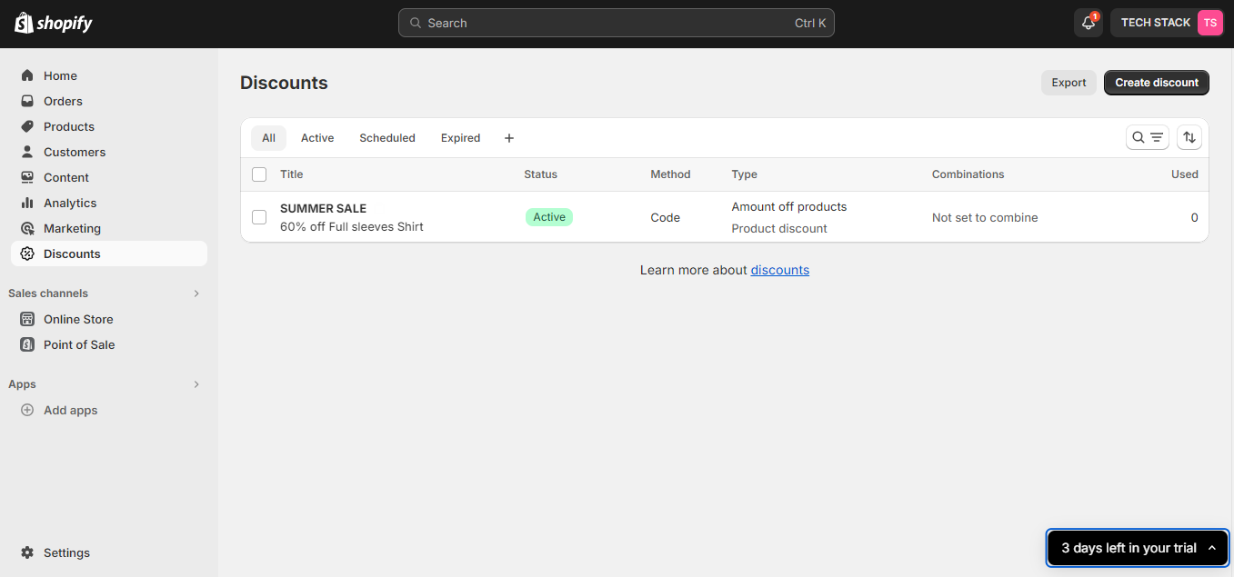
Week #2
AI Academy®
Dashboard Offers and Promotions:
15

Slide 16
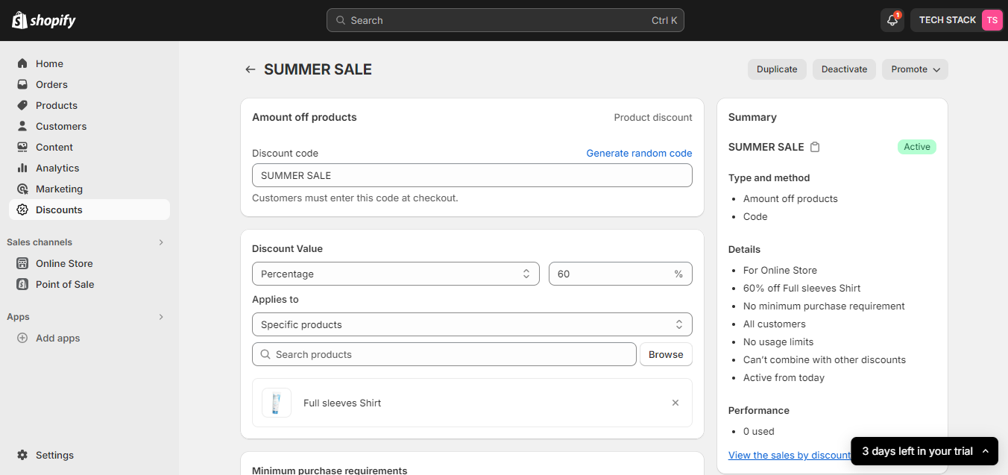
Week #2
AI Academy®
Dashboard Offers and Promotions:
16

